Slide 1

Dining Philosophers’ Problem Part 2
Authors: tom Antoniraj

Slide 2
Declaration
We are aware of the University policy on plagiarism in assignments and examinations (3AS08) We understand that plagiarism, collusion, and copying are grave and serious offences in the Institute and We will accept the penalties that could be imposed if we engage in any such activity. This assignment, or any part of it, has not been previously submitted by me or any other person for assessment on this or any other course of study. We declare that this material, which We now submit for assessment, is entirely of my own work and has not been taken from the work of others, save and to the extent that such work has been cited and acknowledged within the text of my work.

Slide 3
Introduction: Lefty and Righty: Philosopher take chopsticks from their right side. Their way of Different faults it may have are Deadlock and Starvation. Along with the Pros and Cons. Other Solution: 4-Chairs, Principles it has along with the comparison with Lefty and Righty and the different problems it has. Mutexes: Looking into the different mutexes ML, MU, MW. What purpose do they have with the two solutions. Final Analysis: To compare the two and to see the different problems they have or see if they have any similarities.
The Dining Philosophers Problem

Slide 4
Pros & Cons:
How Deadlock Works: It is avoided, however a philosopher has a chopstick and must wait for another.
Starvation: Some are stuck and a few continue or all are stuck, making none able to eat.
Fairness: Not guaranteed. Some may eat more compared to others.
Efficiency: Good for a small number of philosophers. Not For a large amount
Mutual Exclusion | A chopstick can be held by only one philosopher at a time.
Hold and Wait | A philosopher holding one chopstick waits for the second.
No Preemption | A philosopher can’t force another to give up a chopstick.
Circular Wait | Philosopher A waits for B, B waits for C,C waits for E, E waits for A.

Slide 5
In-Depth Mutexes.
Mutex Lock: (chopstick) if it is free it is required immediately. If locked already, the philosopher is put to sleep and added to a mutex queue.
A spinlock before sleeping makes the philosopher to briefly wait trying to acquire the lock.
Recursive Locking allows for a philosopher to acquire a lock multiple times.
Trying to acquire two chopsticks
Dining Philosopher

Slide 6
In-Depth Mutexes.
Mutex Unlock: If no mutex is waiting, it is free allowing the philosopher to wake up to claim and be in use.
When the philosopher is awake the system for fairness may do first in, first out in order, which tries to keep the system fair.
Unlocking a mutex doesn’t guarantee that the next philosopher immediately runs, it only makes the mutex acquirable.
Making the chopsticks after use be unlocked for another thread to use
Dining Philosopher

Slide 7
In-Depth Mutexes.
Mutex Wait: It blocks or (waits), which is efficient by not making the philosopher go back to sleep.
Spurious Wakeups: The system can wake up sleeping philosophers waiting even if the chopsticks aren’t available. (to do with the code)
Timeouts: Some systems allow lock_with_timeout(), where a thread tries to lock but only waits a limited times before giving up.
Chopstick is locked, therefore making other threads wait for it to finish
Dining Philosopher

Slide 8
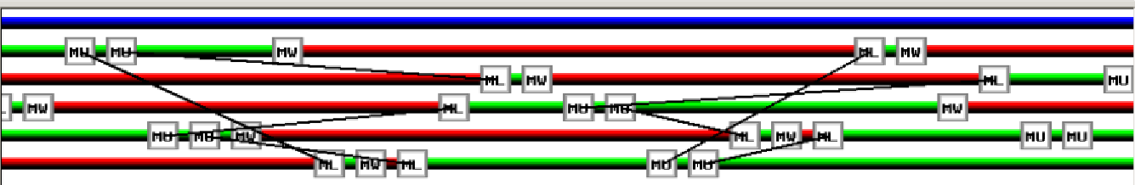
Diagram of the Mutex in Action

Slide 9
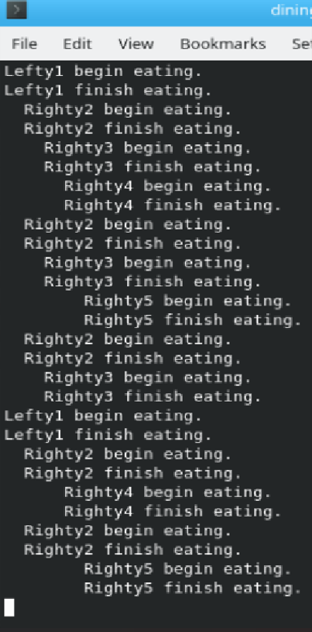
Running on Konsole for the Mutex
----------------------------------------------------------
The intervals of each philosopher.
Some are eating more regular compared to some others.
It is efficient due to the number presented.

Slide 10
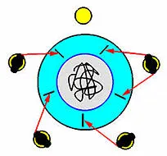
Four Chair Solution
Idea: 5 philosophers at table instead of 4
Solution: semaphore is added, initialised to 4.

Slide 11
Four Chair Solution
How it works:
Before attempting to grab a chopstick, a philosopher must sit at the table by waiting
4 philosophers at table, semaphore is 4
Once 4 are sat, the 5th must wait
Once a philosopher finishes eating, they release their chair for the waiting philosopher.

Slide 12
Deadlock:
Deadlock is eliminated.
Why, 5 philosophers can’t all grab one chopstick and wait forever.
Starvation:
If unlucky, a philosopher could continuously get skipped. If others are faster etc;
Fairness:
Still unfair.
OS timing and thread scheduling chooses which to run.
Causing some philosophers to eat much more often than others.
Efficiency:
Not efficient
Having to block philosophers, means CPU cycles are being wasted.
Pros & Cons

Slide 13
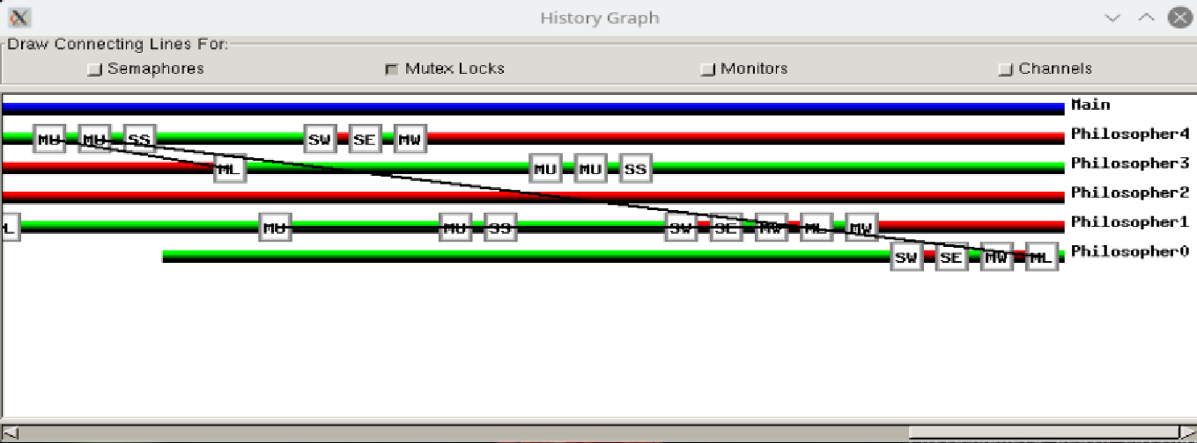
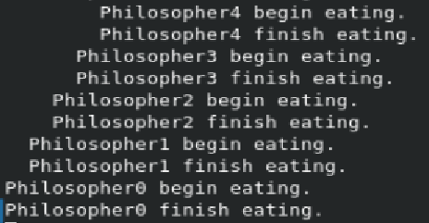
Four Chair Solution
What's happening?
1. Philosopher asks to sit (Semaphore Wait)
2. If seat is free philosopher sits.
3. Philosopher picks right and left chopstick (Mutex Lock).
4. Philosopher eats (Semaphore Eat).
5. Philosopher finishes with chopsticks (Mutex Unlock).
6. Philosopher gets up from seat(Semaphore Signal)

Slide 14
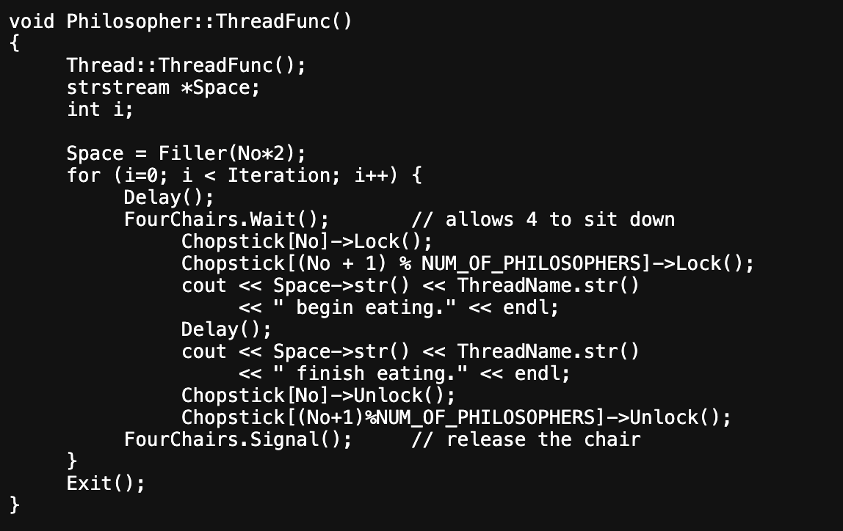
Four chair Solution Code

Slide 15
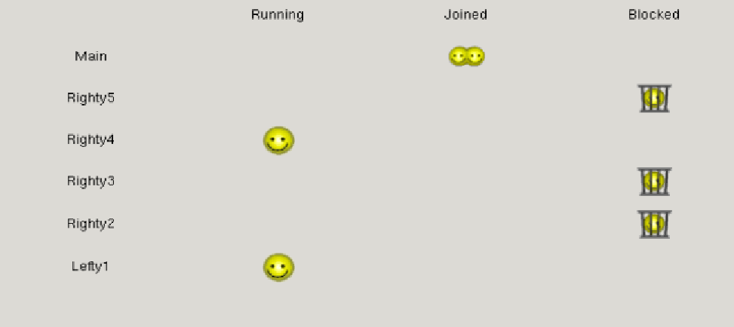
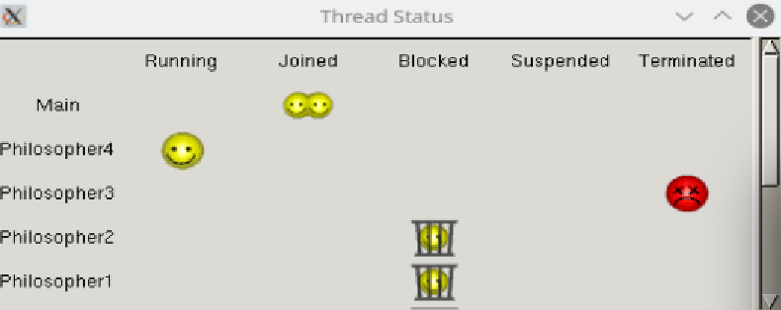
Hierarchy Comparison
Lefty righty Solution
4 Chair Solution

Slide 16
Conclusion
Lefty Righty:
Looked into the pros and cons of the solution
We looked into the mutexes and what their purpose was within the lefty and righty solution. different methods in each mutex make them act the way they’re supposed to.
Four Chairs:
We went over the basics and there is 4 philosophers sitting at the table, and one is out, whereas the lefty and righty solutions include all five.
We looked at the pros & cons. The problems that occur with the four chairs and there are three semaphores which are not in the lefty and righty
Results:
There are different pros & cons
Lefty and Righty only have mutexes, whereas Four Chairs has semaphores and mutexes.
For the hierarchy, we tested that the Four Chairs philosophers get terminated eventually.

Slide 17
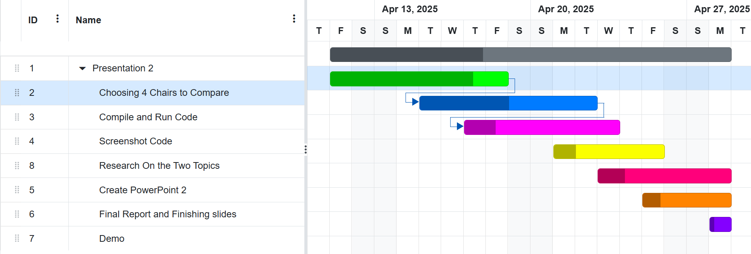
Gantt Chart

